Slide 1

HPCM Logs with OpenTelemetry in Grafana Loki for Observability
Lavanya L
Raghul Vasudevan
February 4, 2025
© 2025 Hewlett Packard Enterprise Development LP

Slide 2

Agenda
WHAT IS HPC
INTRODUCTION TO HPCM
HPCM MONITORING FRAMEWORK
ABOUT THE PROJECT
NEXT STEPS
© 2025 Hewlett Packard Enterprise Development LP

Slide 3
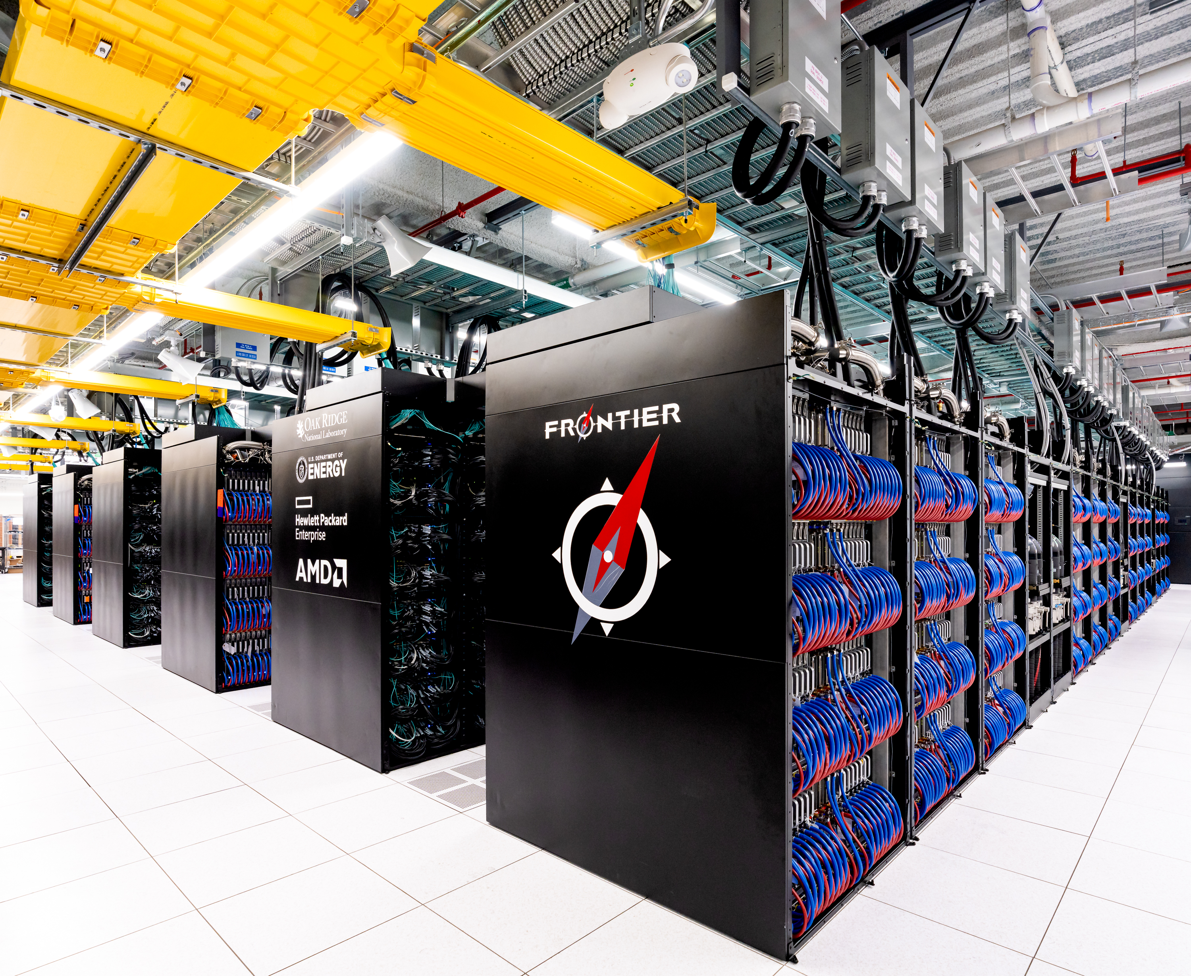
HPC
High Performance Computing
Set of Computing technologies for very fast numeric simulation, modeling and data processing
Employed for specialised applications that require lot of mathematical calculations
Using computer power to execute a few applications extremely fast
• High Performance Computing (HPC) is the use of parallel processing for running advanced application programs efficiently, reliably and quickly.
• A supercomputer is a system that performs at or near the currently highest operational rate for computers.

Slide 4
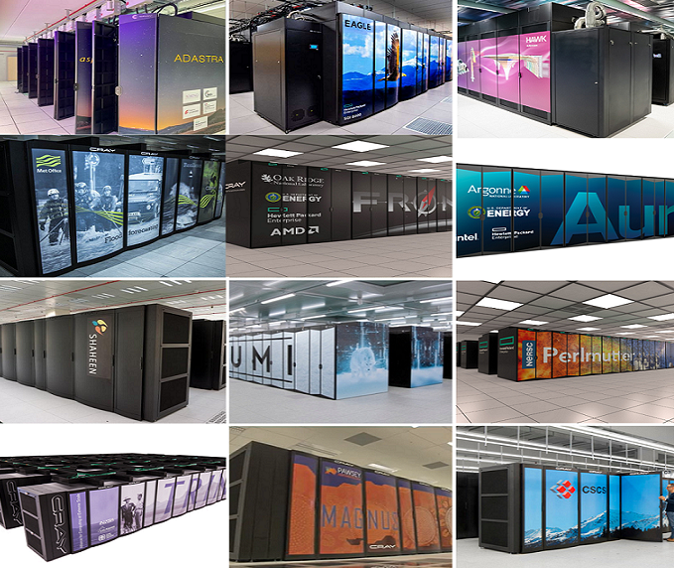
HPE DEPLOYED SUPERCOMPUTERS

Slide 5
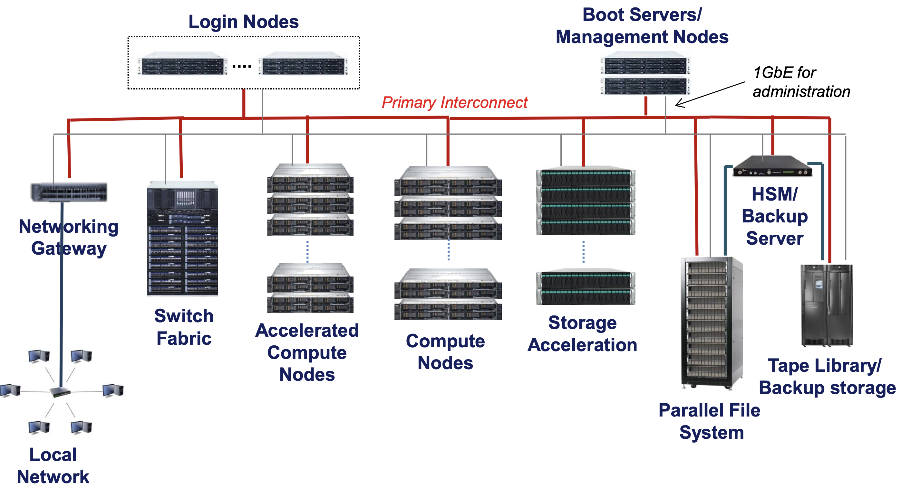
HPCM
HPE Performance Cluster Manager offers comprehensive monitoring and management for nodes, chassis and racks as well as power distribution units (PDU) and cooling hardware.
Overall, HPE Performance Cluster Manager delivers a comprehensive cluster management environment with resiliency, security, operational efficiency and scale for HPE Apollo, HPE Cray EX, SGI and ProLiant high performance computing clusters.
© 2025 Hewlett Packard Enterprise Development LP

Slide 6
HPCM Monitoring Framework
Data Sources
Service Infrastructure Monitoring
User Interfaces
WLM—PBS Pro & SLURM
Events and Telemetry
Monitoring Framework
AIOps
Dashboards
Fabric—Slingshot & InfiniBand
Events and Telemetry
Grafana
OpenSearch
HPE Cray EX, HPE Cray XD and HPE Apollo
Redfish End points & Sensor Data
Mosquitto
OpenSearch
subsmon
Alerts
Compute systems
CPU, GPU, Memory, Disk Telemetry and Events
Alertmanager
Storage and Filesystems
GlusterFS
telegraf
Kafka
CDU Events and Telemetry
pcim
Victoria Metrics
Customer Integration
Power and Heartbeat Monitoring
Rest API
Data Pipeline
Persistent Storage
Syslog
Management hardware and software
Victoria Metrics
© 2024 Hewlett Packard Enterprise Development LP

Slide 7
PROBLEM STATEMENT
HPCM Logs with OpenTelemetry in Grafana Loki for Observability
Improve logs observability and analysis for HPE High Performance Cluster Manager (HPCM), system and application logs.
Transition from manual log analysis to an intuitive, graphical interface with Grafana Loki.
© 2025 Hewlett Packard Enterprise Development LP

Slide 8
CURRENT CHALLENGES
Manual Log Observation:
Users have to manually open and read multiple log files to find errors or issues.
Time-Consuming Debugging:
Debugging takes a lot of time because users need to search through large amounts of data.
Complex Linux Commands:
Users often rely on advanced Linux commands to find patterns or errors, which can be difficult.
No Centralized System:
Logs are scattered, and there’s no single tool to view or analyse all logs together.
Limited Insights:
Without proper tools, users can miss important patterns or trends in the data, making troubleshooting harder.
© 2025 Hewlett Packard Enterprise Development LP

Slide 9
Architecture
Grafana
HPCM/System Logs
Fluent Bit
Logstash
OpenSearch DB
Grafana Loki
Kafka Topic
Alertmanager
© 2025 Hewlett Packard Enterprise Development LP

Slide 10
SCOPE
Set up a self-contained monitoring system like HPCM on a dedicated platform, incorporating Kafka, OpenSearch, and Logstash for real-time data processing and storage.
Build a simulator to generate diverse log types into Kafka, including:
System Logs for operational metrics and performance.
Application Logs for debugging and error analysis.
Service Infrastructure Monitoring Logs for tracking system health and resource utilization.
Standardize HPCM logs using the OpenTelemetry format to enhance interoperability and flexibility.
Enable centralized and structured log visualization through Grafana Loki, improving troubleshooting, debugging, and monitoring workflows.
Handle Scenarios Like:
Create dynamic dashboards to track trends in error rates, system health, and log patterns.
Improved logs observability and user experience.
Ensure seamless interoperability of Kafka, Logstash, OpenSearch, and Grafana Loki.
© 2025 Hewlett Packard Enterprise Development LP

Slide 11
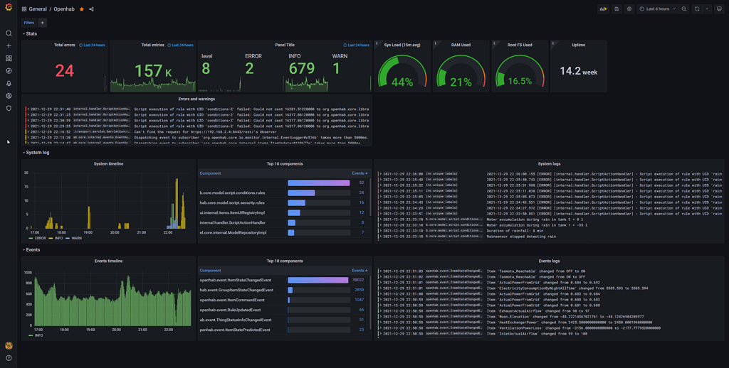
EXPECTED OUTCOME
Demonstrate a centralized log visualization framework that improves troubleshooting, simplifies analysis, and supports proactive monitoring of system and application logs.

Slide 12
Kick start guide
Grafana - play around and get hands-on
Grafana Loki - https://grafana.com/oss/loki/
Opensearch DB – study, Install, config and get hands-on
Logstash - study, Install, config and get hands-on
Kafka - study, Install, config and get hands-on
FluentBit - study, Install, config and get hands-on
SYSTEM SETUP
Virtual Machine Configuration
RHEL/SLES Configuration
Monitoring Stack Installation – Kafka, Opensearch, Logstash, Grafana, FluentBit
Enable Logging
Log Simulation
Validation
© 2025 Hewlett Packard Enterprise Development LP

Slide 13
Thank you
lavanya.l@hpe.com
raghulvasudevan@hpe.com

